Slide 1


Modern Game Engine - Theory and Practice
Lecture 06
Rendering on Game Engine
The Challenges and Fun of Rendering the Beautiful Mother Nature
WANG XI
GAMES 104
2022

Slide 2
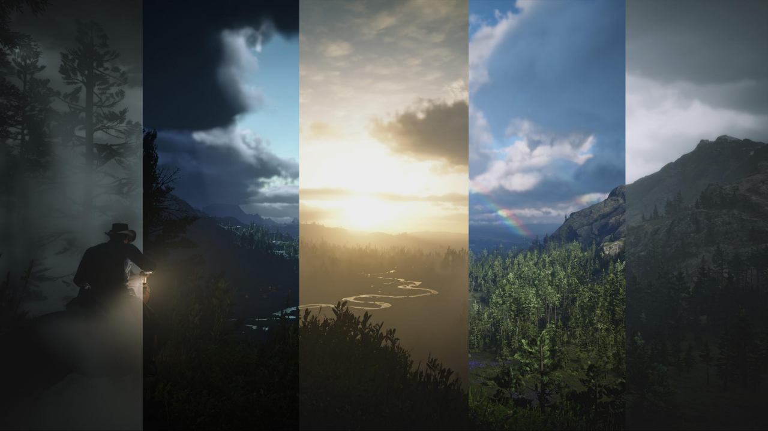
Modern Game Engine - Theory and Practice
Red Dead Redemption

Slide 3
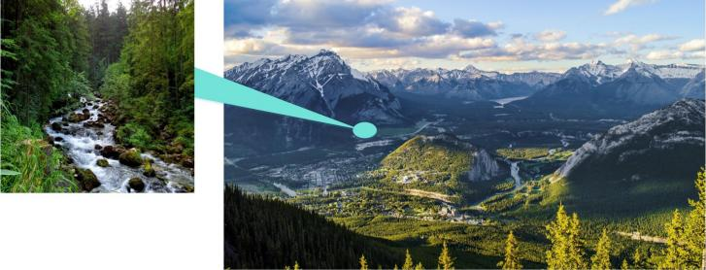
Modern Game Engine - Theory and Practice
Real-World Landscape
• Huge geospatial scale
• Rich geomorphological
l Vegetation
l Rivers
l Undulating peaks
l Alpine snow
l … …
Too Complex for Rendering Using Traditional Mesh + Material

Slide 4

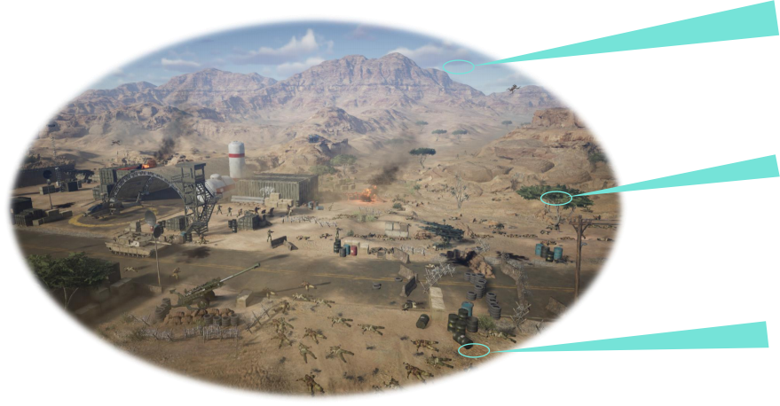

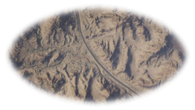
Modern Game Engine - Theory and Practice
Environment Components in Games
Sky and Cloud
V ation
缺植
eg被et
Terrain

Slide 5
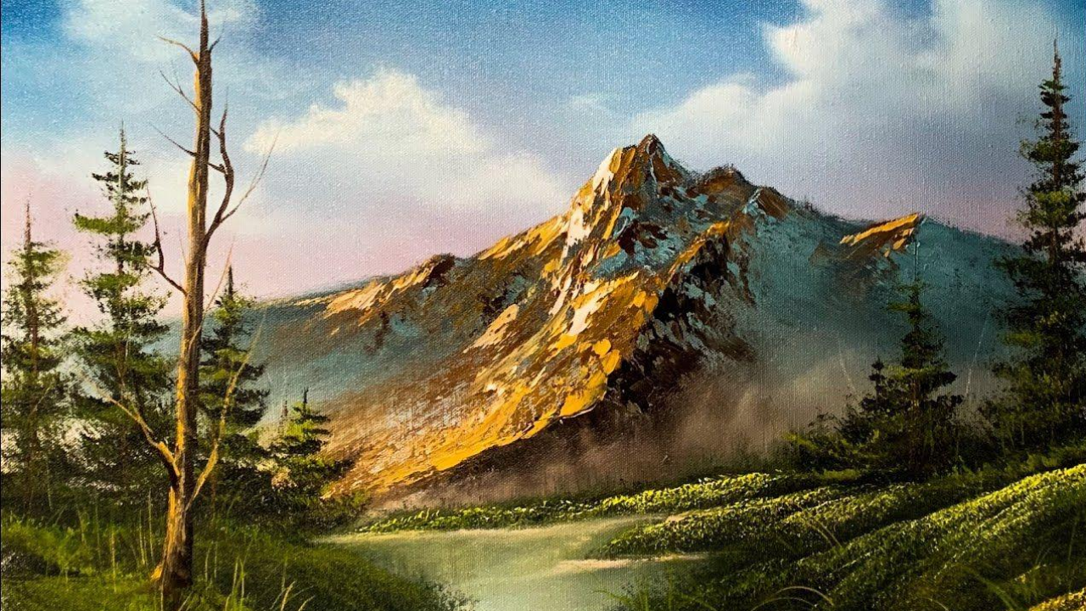
Modern Game Engine - Theory and Practice
Terrain Rendering

Slide 6
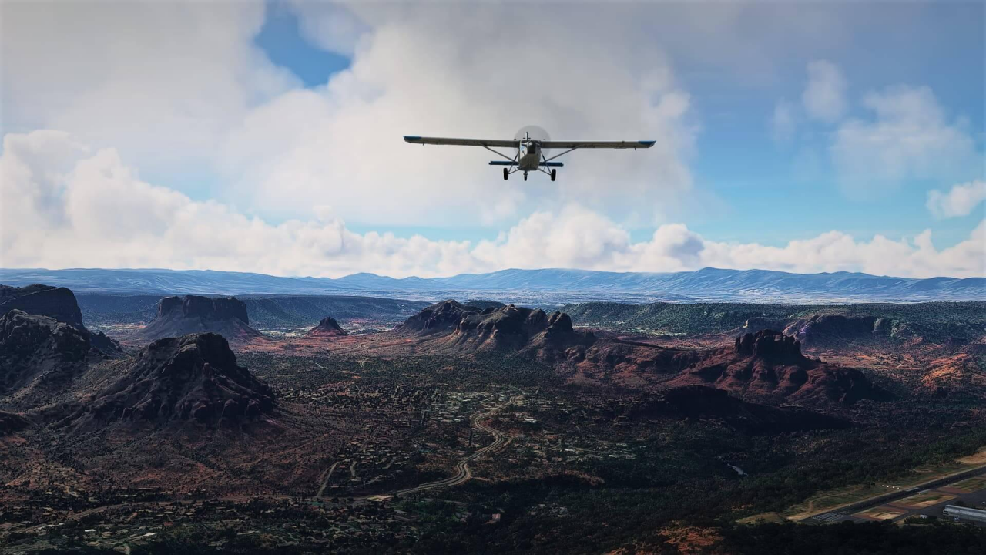
Modern Game Engine - Theory and Practice
Microsoft Flight Simulator

Slide 7
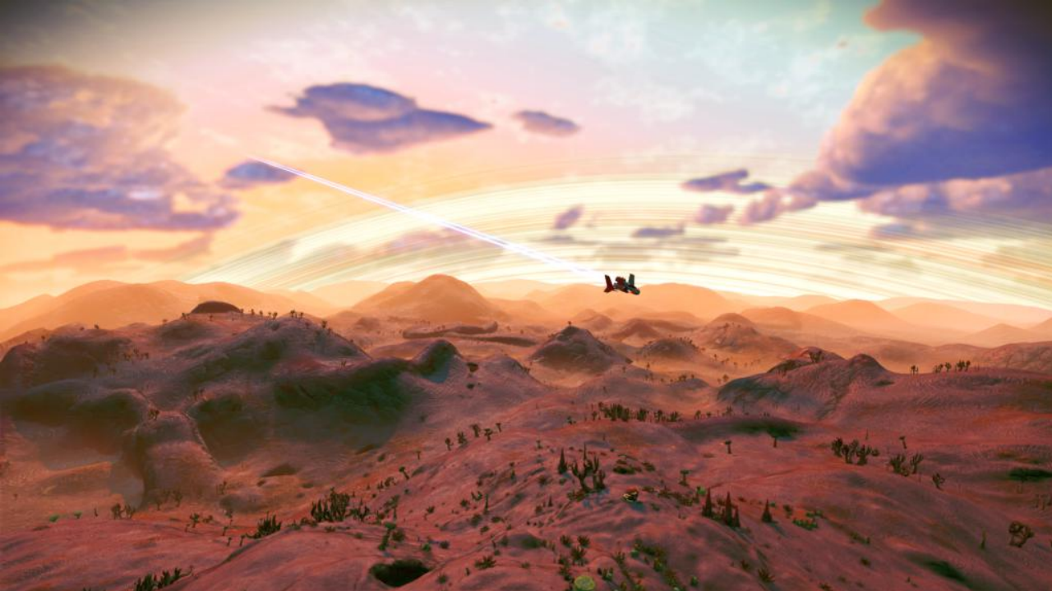
Modern Game Engine - Theory and Practice
No Man’s Sky

Slide 8
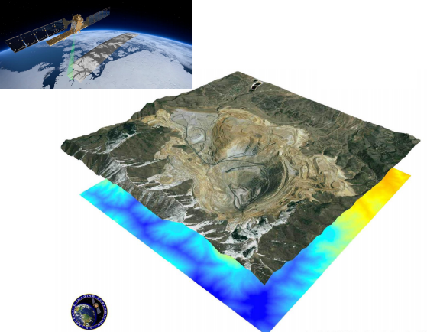
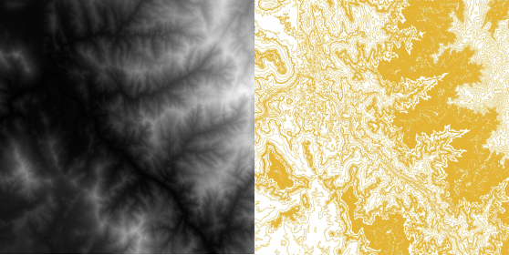
Modern Game Engine - Theory and Practice
Simple Idea - Heightfield
• Satellite image and google earth
Height Map Contour Map

Slide 9
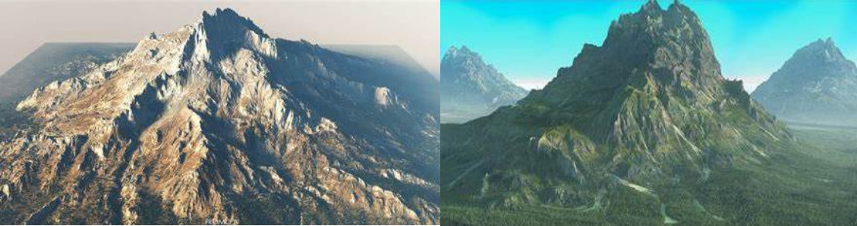
Modern Game Engine - Theory and Practice
Expressive Heightfield Terrains

Slide 10
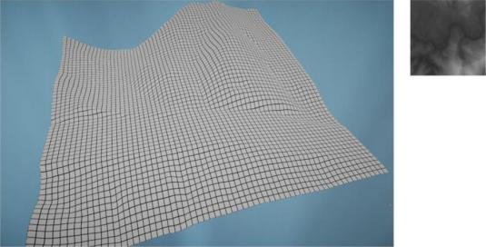
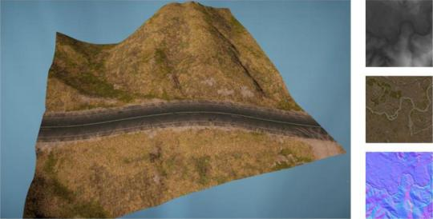
Modern Game Engine - Theory and Practice
Render Terrain with Heightfield
Mesh Grids
Material
1km × 1km map, sample distance 1m Need 2 * 1,000 * 1,000 = 2,000,000 triangles

Slide 11
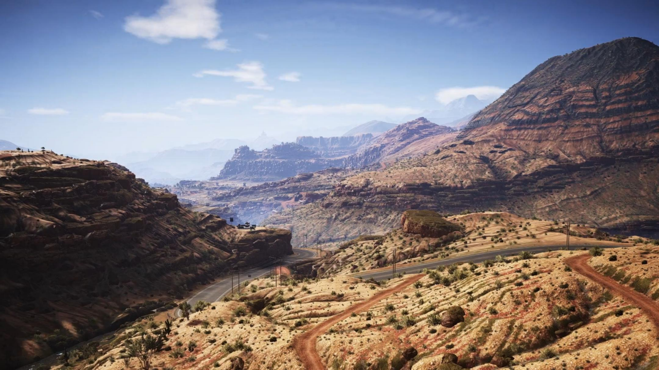



Modern Game Engine - Theory and Practice
Vast Open World

Slide 12
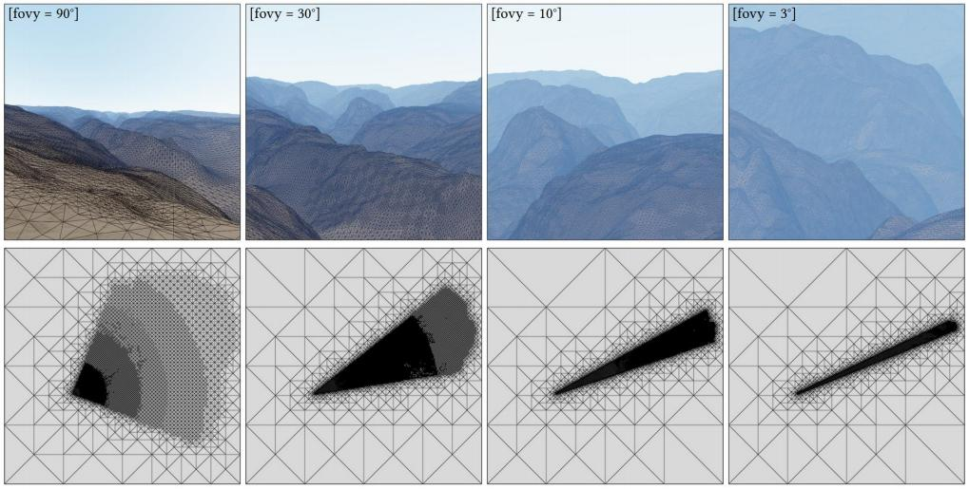
Modern Game Engine - Theory and Practice
Adaptive Mesh Tessellation

Slide 13
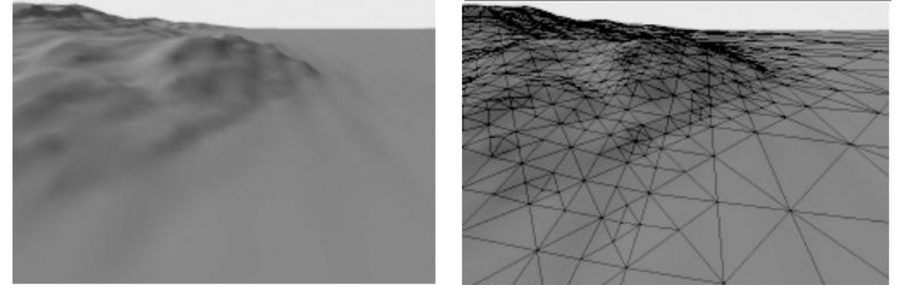
Modern Game Engine - Theory and Practice
Two Golden Rules of Optimization
View-dependent error bound
• Distance to camera and FoV
• Error compare to ground truth (pre-computation)

Slide 14
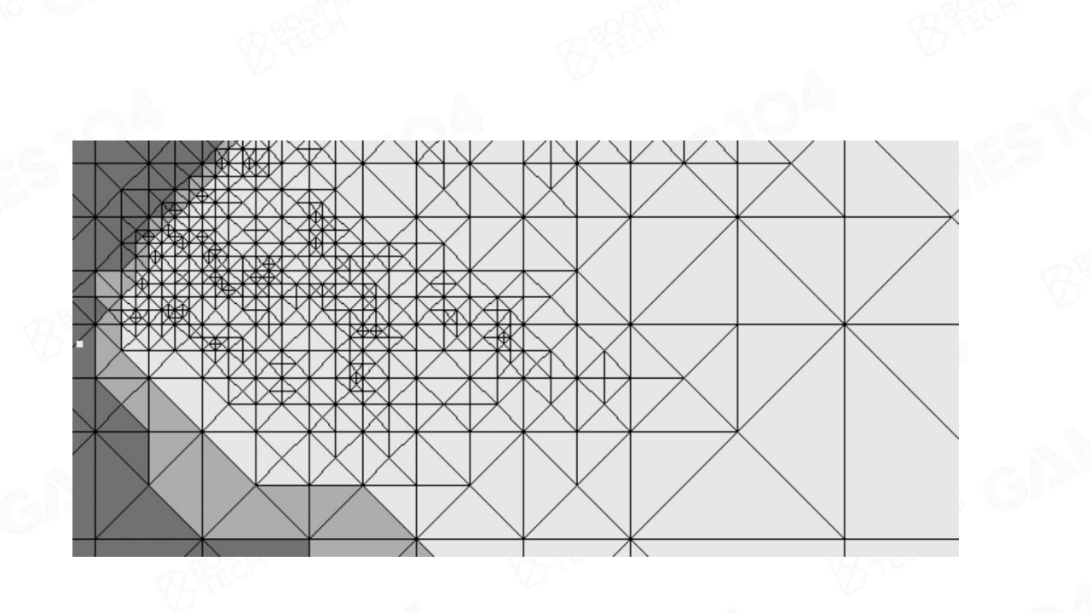
Modern Game Engine - Theory and Practice
Triangle-Based Subdivision

Slide 15
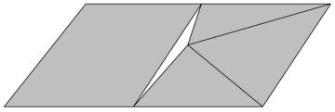
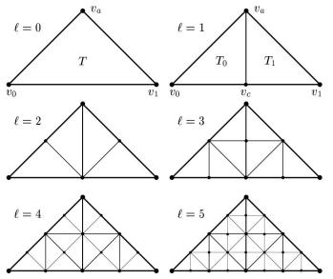
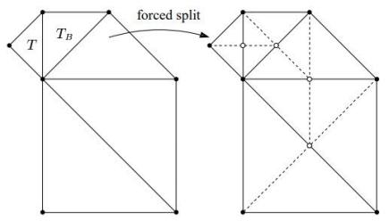
Modern Game Engine - Theory and Practice
Subdivision and T-Junctions
Continuously partitioning triangles and their children based on the idea of binary trees
T-Junction

Slide 16
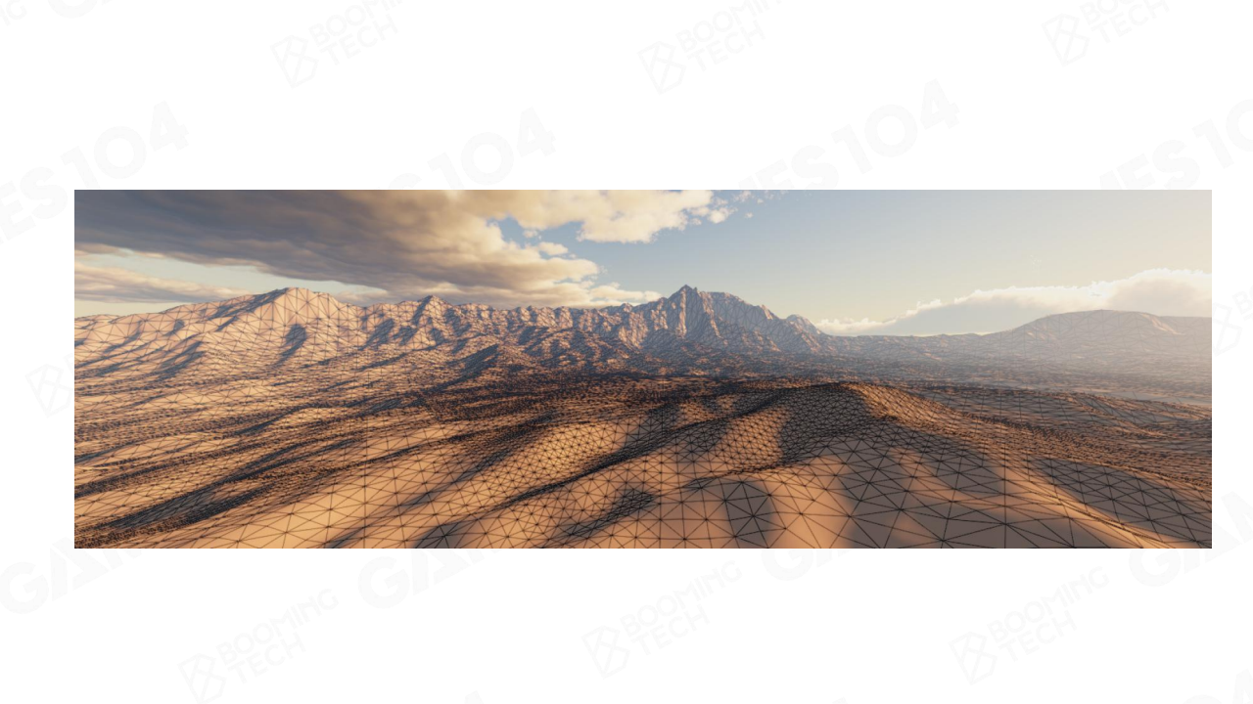
Modern Game Engine - Theory and Practice
Triangle-Based Subdivision on GPU
SIGGRAPH 2021: Experimenting With Concurrent Binary Trees for Large-scale Terrain Rendering
54×54 km terrain on GPU using Unity game engine

Slide 17
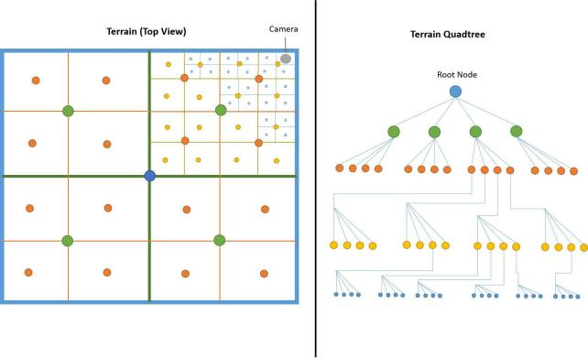
Modern Game Engine - Theory and Practice
QuadTree-Based Subdivision
Pros
• Easy to construct
• Easy management of data under geospatial, including objects culling and data streaming
Cons
• Mesh subdivision is not as flexible as triangle mesh
• The grid level of the leaf nodes needs to be consistent

Slide 18
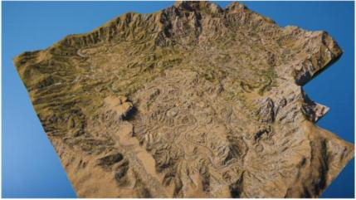
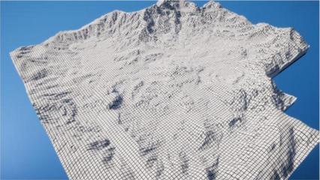
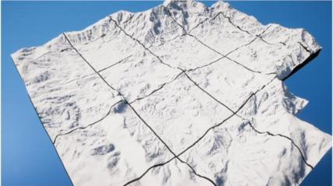
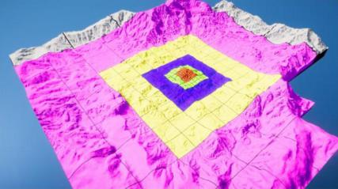
Modern Game Engine - Theory and Practice
Original Terrain
Highest Resolution Grid
Lowest Resolution Grid
Terrain Quad Tree

Slide 19
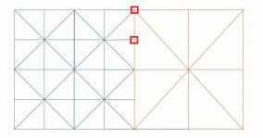
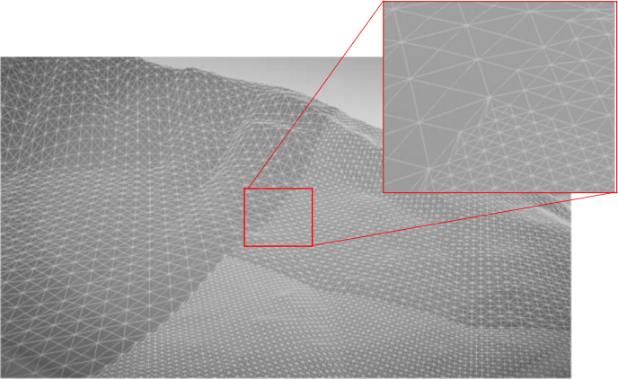
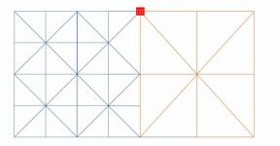
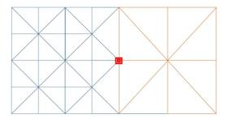
Modern Game Engine - Theory and Practice
Solving T-Junctions among Quad Grids
Source
Stitching Step 1
Mesh LoD Stitching

Slide 20

Modern Game Engine - Theory and Practice
加一页现代游戏关于 chunked方法实现的效果图
farcry5， 仅示 意要替换
Terrain Rendering with Quad Grid
Far Cry V

Slide 21
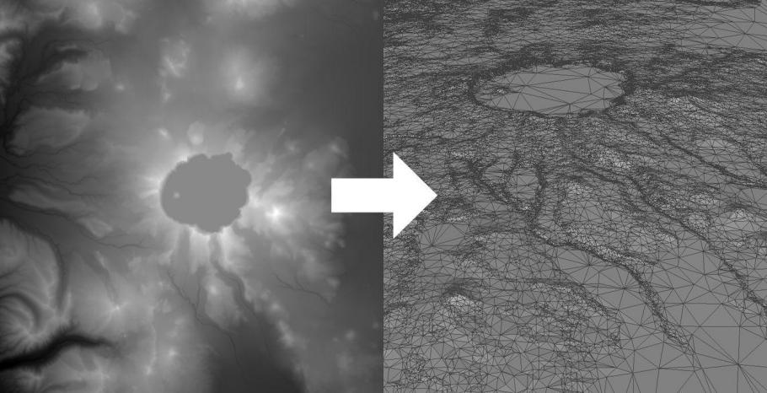
Modern Game Engine - Theory and Practice
Triangulated Irregular Network (TIN)

Slide 22
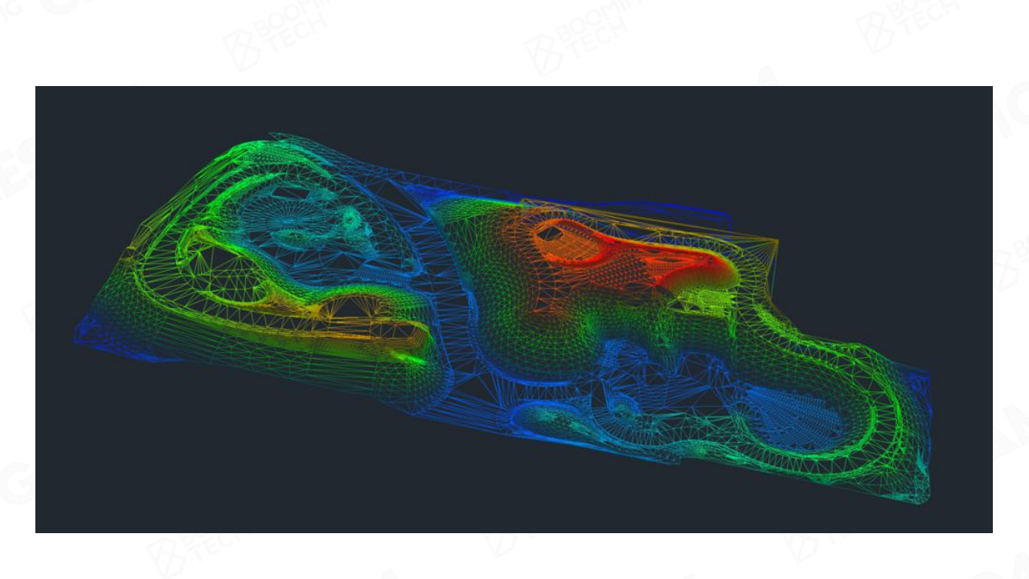
Modern Game Engine - Theory and Practice
Density Variants in TIN

Slide 23
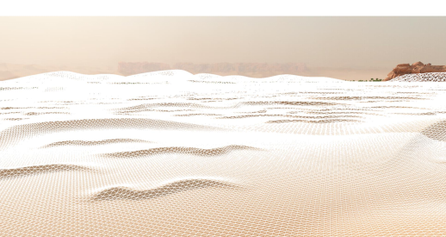
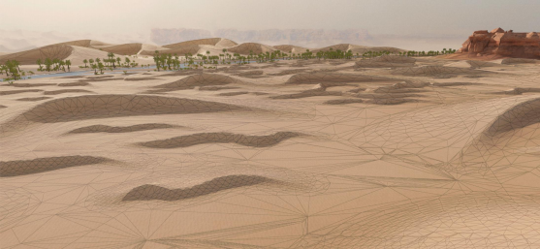
Modern Game Engine - Theory and Practice
Triangulated Irregular Network vs. Adpative Tessellation
Pros
• Easy in runtime rendeirng
• Less triangls in certain terrain types
Cons
• Requires certain pre-processing steps
• Poor reusability
Clip-Map LOD (170,000 Triangles)
Mesh LOD (50,000 Triangles)
GDC2021 Boots on the Ground: The Terrain of Call of Duty

Slide 24
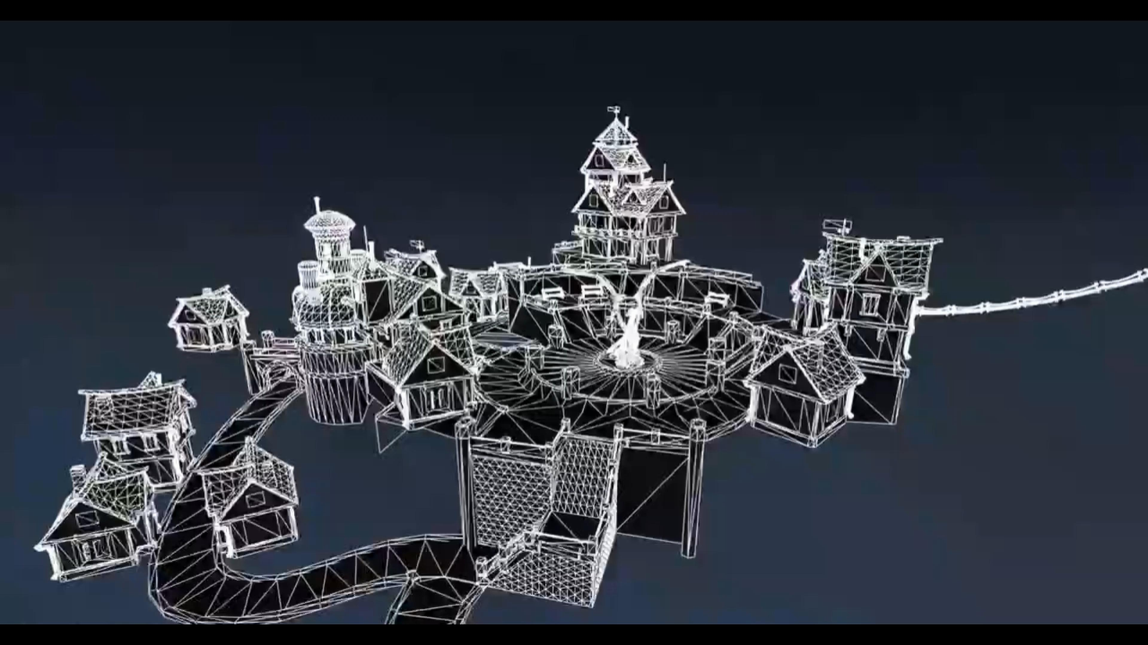
Modern Game Engine - Theory and Practice
GPU-Based Tessellation

Slide 25
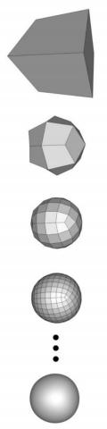
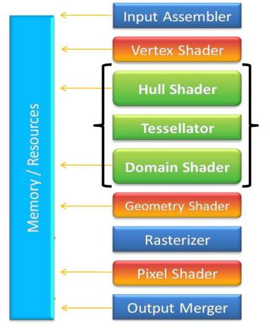
Modern Game Engine - Theory and Practice
Hardware Tessellation
Hull-Shader Stage - transforms basis functions from base mesh to surface patches
Tessellator Stage - produces a semi-regular tessellation pattern for each patch
Domain-Shader Stage - a programmable shader stage that calculates the vertex position that corresponds to each domain sample

Slide 26
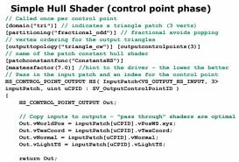
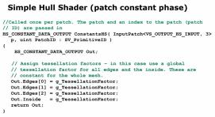
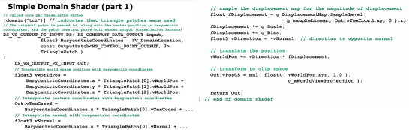
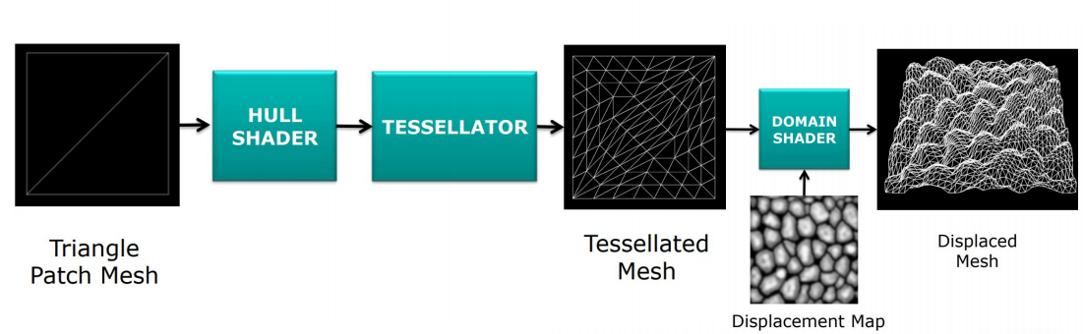
Modern Game Engine - Theory and Practice

Slide 27
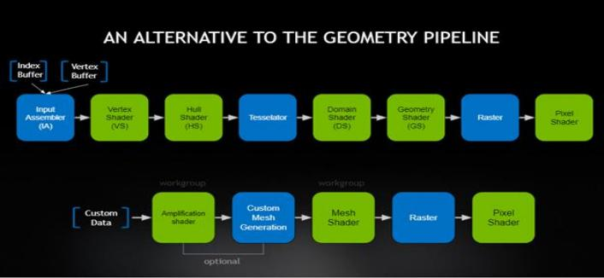
Modern Game Engine - Theory and Practice
Mesh Shader Pipeline
• Amplification Shader Stage - decides how • Mesh Shader Stage - produces a semi-regular
many Mesh shader groups to run and passes tessellation pattern for each patch, and outputs
data to those groups comprise vertices and primitives

Slide 28
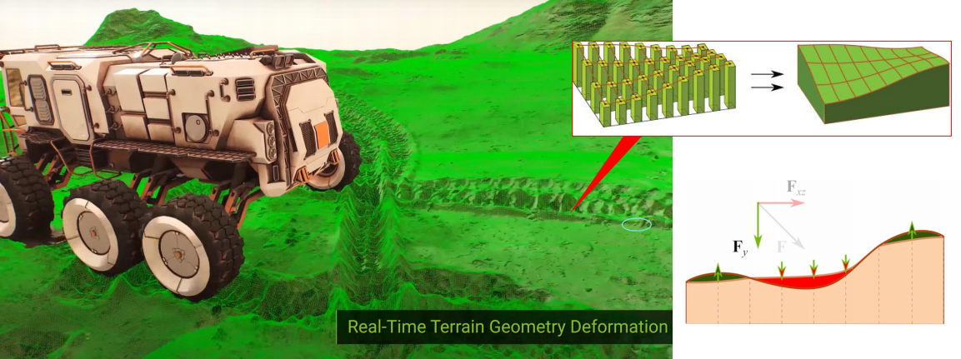
Modern Game Engine - Theory and Practice
Real-Time Deformable Terrain

Slide 29
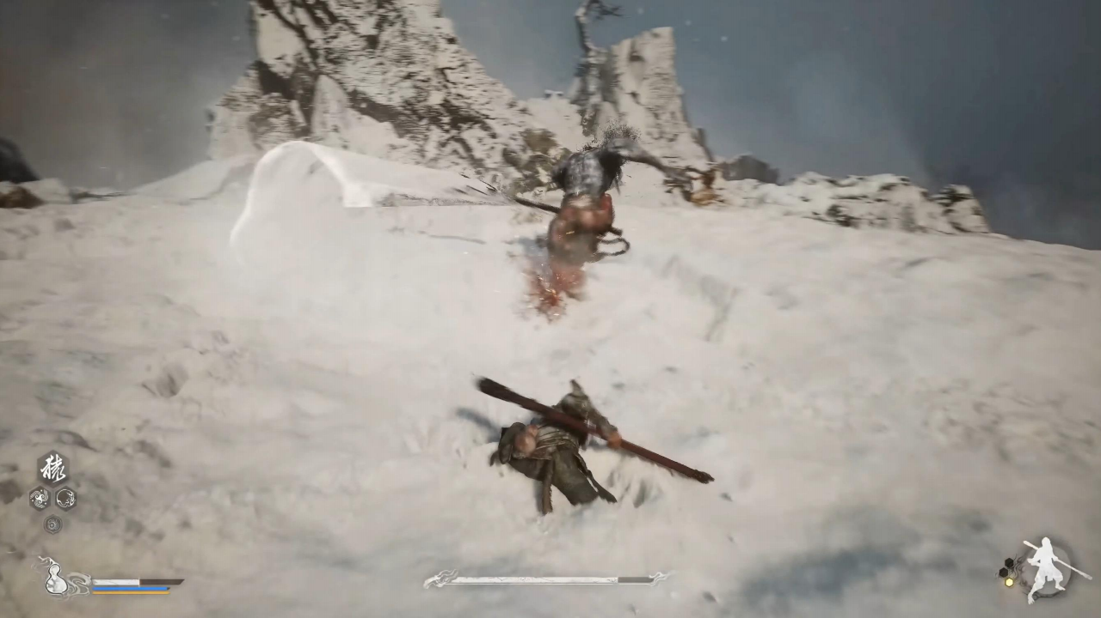
Modern Game Engine - Theory and Practice

Slide 30
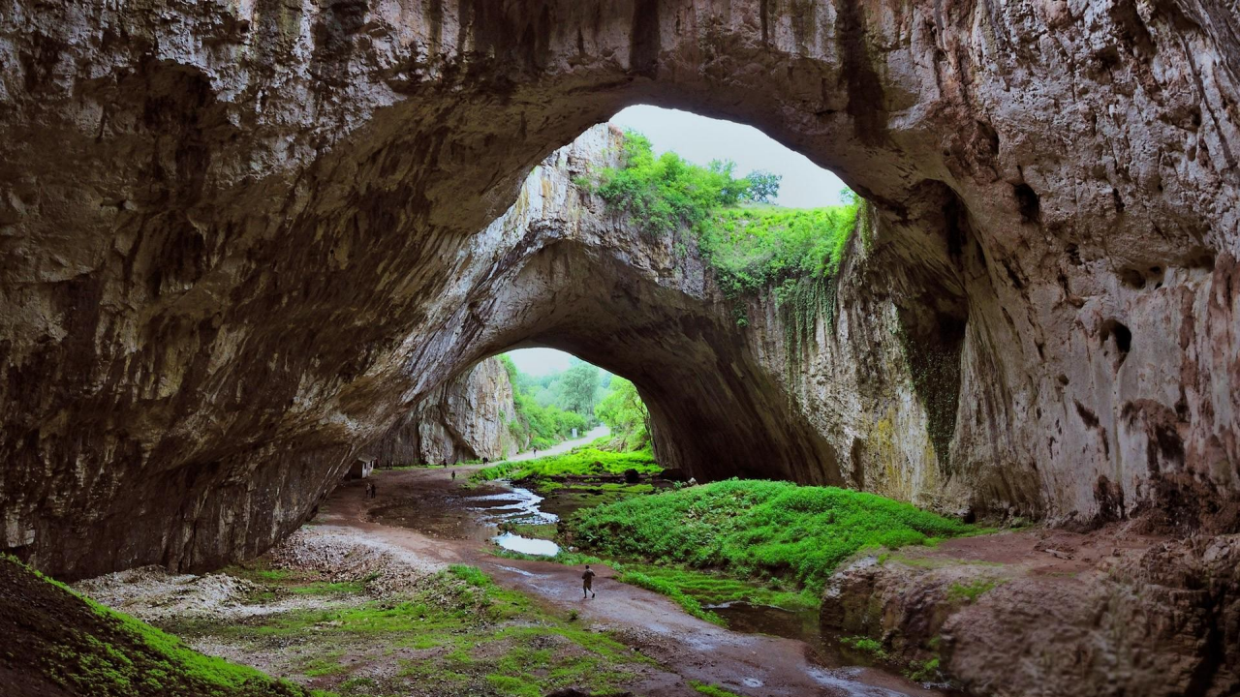
Modern Game Engine - Theory and Practice
Non-Heightfield Terrain

Slide 31
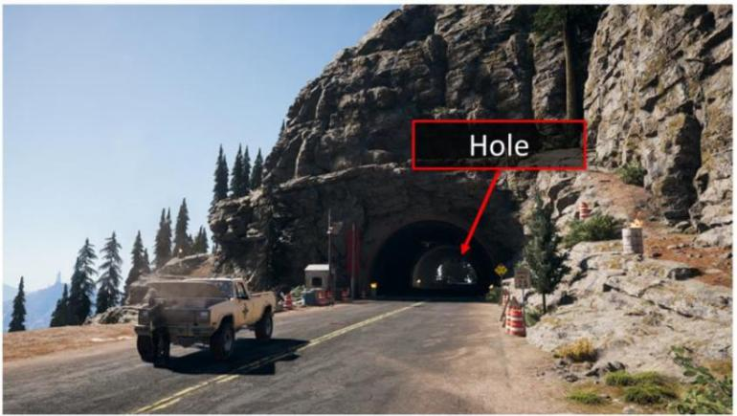
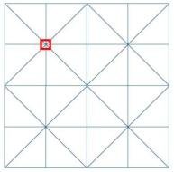
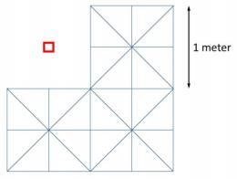
Modern Game Engine - Theory and Practice
Dig a Hole in Terrain
Output 1 NaN Vertex Position
Kill a Quad

Slide 32
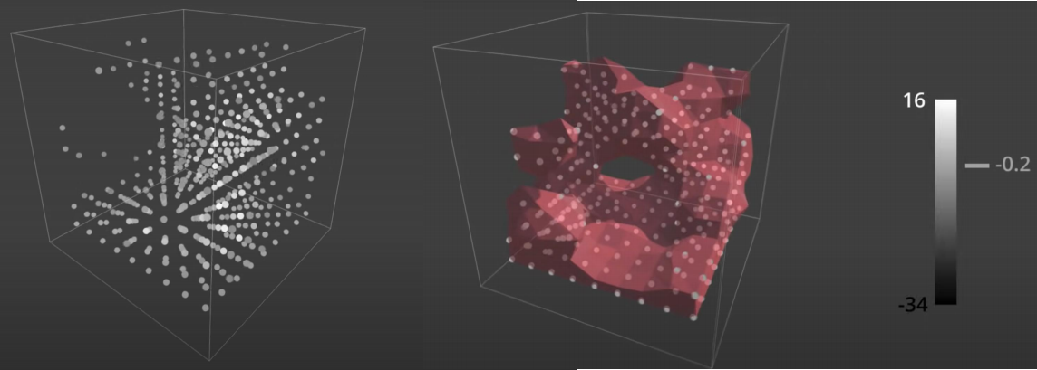
Modern Game Engine - Theory and Practice
Crazy Idea - Volumetric Representation
In 3D computer graphics, a voxel represents a value on a regular grid in three-dimensional space. As pixels in a 2D bitmap, voxels themselves do not typically have their position (i.e. coordinates) explicitly encoded with their values

Slide 33
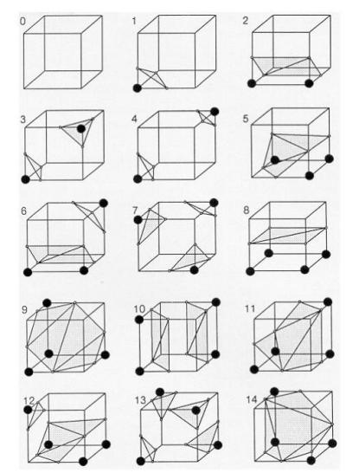

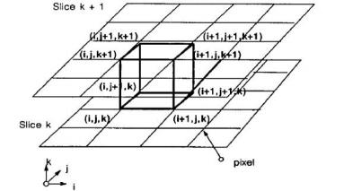

Modern Game Engine - Theory and Practice
Marching Cubes
MARCHING CUBES: A HIGH RESOLUTION 3D SURFACE CONSTRUCTION ALGORITHM'; Computer Graphics, Volume 21, Number 4, July 1987

Slide 34


Modern Game Engine - Theory and Practice
Transition Cell Lookup Table
Transvoxel Algorithm
• Constructs the triangulation of transition cells to form a lookup table, and uses this lookup table to do the triangulation of LOD voxel cubes
Lengyel, Eric. (2010). Voxel-Based Terrain for Real-Time Virtual Simulations.

Slide 35

Modern Game Engine - Theory and Practice
Make AAA as Flexible as Minecraft??? :-)

Slide 36


Modern Game Engine - Theory and Practice
Paint Terrain Materials

Slide 37

Modern Game Engine - Theory and Practice
11 Biomes 140 Materials
Ghost Recon Wildlands

Slide 38









Modern Game Engine - Theory and Practice
Terrain Materials
Material Blend Map 应该是彩色的
Roughness
Base Color
Normal
Height
Material blending result

Slide 39



Modern Game Engine - Theory and Practice
Simple Texture Splatting
Smooth but unnatural
Simple Blending

Slide 40



Modern Game Engine - Theory and Practice
Advanced Texture Splatting
Height Maps
Blending with Height
float3 blend(float4 texture1, float height1, float4 texture2, float height2) {
return height1 > height2 ? texture1.rgb : texture2.rgb;
}
Height Maps + Alpha Blending

Slide 41


Modern Game Engine - Theory and Practice
Advanced Texture Splatting - Biased
float3 blend(float4 texture1, float height1, float4 texture2, float height2)
^{float} ^{depth} ⁼ ^{0.2;} ^{Height} ^{Bias}
float ma = max(texture1.a + height1, texture2.a + height2) - depth; float b 1 = max(texture1.a + height1 - ma, 0);
float b2 = max(texture2.a + height2 - ma, 0);
return (texture1.rgb * b 1 + texture2.rgb * b2) / (b1 + b2); }
Links:
https:/www.gamedeveloper.com/programming/advanc ed-terrain-texture-splatting
{

Slide 42




Modern Game Engine - Theory and Practice
Sampling from Material Texture Array
Material Texture Array

Slide 43


Modern Game Engine - Theory and Practice
Parallax and Displacement Mapping
Parallax Mapping: Due to the height of the surface, the eye sees point B instead of point A. It creates a sense of dimensionality
Color mapping
Bump mapping
Parallax mapping
Displacement mapping

Slide 44

Modern Game Engine - Theory and Practice
Expensive Material Blending
• Many Texturing - Low performance when multiple materials are sampled too many times
• Huge Splat Map - We only see a small set of terrain, but we load splat maps for 100 square km into video memory

Slide 45





Modern Game Engine - Theory and Practice
Virtual Texture
• Build a virtual indexed texture to represent all blended terrain materials for whole scene
• Only load materials data of tiles based on view- depend LOD
• Pre-bake materials blending into tile and store them into physical textures
Baked Terrain Tile

Slide 46



Modern Game Engine - Theory and Practice
VT Implementation, DirectStorage & DMA
DirectStorage
CPU based cache management among disk, main memory and video memory
DMA

Slide 47




Modern Game Engine - Theory and Practice
Floating-point Precision Error
IEEE 754 float
IEEE 754 double
Floating-point error caused artifacts while camera and
object in large value (from 1m to 60,000km)

Slide 48


Modern Game Engine - Theory and Practice
Camera-Relative Rendering
• Translates objects by the negated world space camera position before any other geometric transformations affect them
• It then sets the world space camera position to 0 and modifies all relevant matrices accordingly
Render a whole galaxy :-)

Slide 49

Modern Game Engine - Theory and Practice

Slide 50

Modern Game Engine - Theory and Practice
Tree Rendering
Tree Rendering LODs

Slide 51


Modern Game Engine - Theory and Practice
Decorator Rendering
Decorator Rendering LODs

Slide 52



Modern Game Engine - Theory and Practice
Road and Decals Rendering
Decals
Spline-based Road Editing and Sculpturing Height Field
Splatting Road and Decals on Virtual Texture

Slide 53

Modern Game Engine - Theory and Practice
Terrain Editing in Game Engine

Slide 54

Modern Game Engine - Theory and Practice
Procedure Terrain Creation

Slide 55

Modern Game Engine - Theory and Practice
Sky and Atmosphere

Slide 56

Modern Game Engine - Theory and Practice
Red Dead Redemption 2

Slide 57

Modern Game Engine - Theory and Practice

Slide 58

Modern Game Engine - Theory and Practice

Slide 59



Modern Game Engine - Theory and Practice
How to "Paint" Everything in the Sky
Sky
Cloud

Slide 60

Modern Game Engine - Theory and Practice
Atmosphere

Slide 61





Modern Game Engine - Theory and Practice
Analytic Atmosphere Appearance Modeling
Photograph
Pros
• Calculation is simple and efficient
Cons
• Limited to ground view
• Atmosphere parameters can’t be changed freely
Rendering
An Analytic Model for Full Spectral Sky-dome Radiance, ACM Trans 2012

Slide 62




Modern Game Engine - Theory and Practice
Participating Media
• Volume ﬁlled with particles
• Interact diﬀerently with light depending on its composition
Atmosphere
Cloud

Slide 63











Modern Game Engine - Theory and Practice
How Light Interacts with Participating Media Particles?
Absorption Coefficient Scattering Coefficient
Radiative Transfer Equation (RTE)
Phase Function
Extinction Coefficient
In-Scattering Function

Slide 64







Modern Game Engine - Theory and Practice
Volume Rendering Equation (VRE)
Camera
Emission
Transmittance: the net reduction factor from absorption and out-scattering
The net increase factor from in-scattering

Slide 65




Modern Game Engine - Theory and Practice
Real Physics in Atmosphere
Sun Light
• Air Molecules N2 O2 O3
• Aerosols Dust Sand

Slide 66

Modern Game Engine - Theory and Practice
Scattering Types
• Rayleigh Scattering
Scattering of light by particles that have a diameter much smaller than the wavelength of the radiation (eg. air molecules）
• Mie scattering
Scattering of light by particles that have a diameter similar to or larger than the wavelength of the incident light (eg. aerosols)
Mie scattering
aerosols
molecules
Rayleigh Scattering

Slide 67

Modern Game Engine - Theory and Practice
Rayleigh Scattering
• Certain directions receive more light than others front-back symmetry
• Shorter wavelengths (eg. blue) are scattered more strongly than longer wavelengths (eg. red)
Rayleigh Scattering Distribution

Slide 68




Modern Game Engine - Theory and Practice
Rayleigh Scattering Equation
Wavelength
^{Density} ^{Geometry}
Rayleigh Scattering Distribution
Scattering Coefficient Phase Function

Slide 69




Modern Game Engine - Theory and Practice
Why Sky is Blue

Slide 70



Modern Game Engine - Theory and Practice
Mie Scattering
• Scatter light of all wavelength nearly equally
• Exhibit a strong forward directivity
Mie Scattering Distribution

Slide 71







Modern Game Engine - Theory and Practice
Mie Scattering Equation
Geometry Parameter
Scattering Coefficient
Phase Function
Mie Scattering Distribution
• g > 0, scatters more forward Mie scattering
• g < 0, scatters more backward
• g = 0, Rayleigh scattering

Slide 72


Modern Game Engine - Theory and Practice
Mie Scattering in Daily Life
• Exhibit a strong forward directivity (halo effects around sun)
• Scatter light of all wavelength nearly equally (fog effects）
Fog
Halo of Sun

Slide 73


Modern Game Engine - Theory and Practice
Variant Air Molecules Absorption
• Ozone (O3)
Absorb strongly at longer wavelengths to filter out the reds, oranges, yellows
• Methane (CH4)
Well-known for absorbing red light
Blue sky near zenith on sunset
Neptune covered by CH4

Slide 74



Modern Game Engine - Theory and Practice
Single Scattering vs. Multi Scattering

Slide 75


Modern Game Engine - Theory and Practice
Single Scattering vs. Multi Scattering
Single Scattering
Multi Scattering

Slide 76





Modern Game Engine - Theory and Practice
Ray Marching
• Ray marching is a popular method to integrate function along a path
• We use ray marching to calculate final radiance for a given point by single scattering
• The integrated radiance is usually stored in look-up tables (LUT)
...
Each step makes some
calculations (eg. lighting)
Sum all steps' results together
Single Scattering Integration

Slide 77









Modern Game Engine - Theory and Practice
Precomputed Atmospheric Scattering
Atmosphere
Top
Transmittance LUT
Height
Atmosphere
ViewZenithCosAngle
Bottom
https://ebruneton.github.io/precomputed_atmospheric_scattering/

Slide 78


Modern Game Engine - Theory and Practice
Precomputed Atmospheric Scattering
Single Scattering LUT Store 4D table in 3D Texture Array
ViewZenithCosAngle
Height
ViewSunCosAngle x 8, SunZenithCosAngle x 32

Slide 79








Modern Game Engine - Theory and Practice
Precomputed Atmospheric Scattering Multi Scattering LUT
Scattered Integration
Transmittance LUT
Light
Multi Scattering LUT
N-order Scattering
Single Scattering LUT

Slide 80

Modern Game Engine - Theory and Practice
Precomputed Atmospheric Scattering

Slide 81
Modern Game Engine - Theory and Practice
Challenges of Precomputed Atmospheric Scattering
• Precomputation Cost
• Multi-scattering iterations are very expensive
• Hard to generate atmosphere LUT on low-end devices (ie. mobile)
• Authoring and Dynamic Adjustment of Environments
• Artist can't change scattering coefficients on the fly
• Hard to render effects like weather from sunny to rain fog, space travel among planets
• Runtime Rendering Cost
• Expensive per-pixel multi high dimensional texture sampling for transmittance LUT and multi scattering LUT (always need to down-sample for efficiency)
A Scalable and Production Ready Sky and Atmosphere Rendering Technique
https://diglib.eg.org/bitstream/handle/10.1111/cgf14050/v39i4pp013-022.pdf

Slide 82



Modern Game Engine - Theory and Practice
Production Friendly Quick Sky and Atmosphere Rendering
Simplify Multi-scattering Assumption
• Scattering events with order greater or equal to 2 are executed using an isotropic phase function
• All points within the neighborhood of the position we currently shade receive the same amount of second order scattered light
• Visibility is ignored
Multi Scattering LUT

Slide 83





Modern Game Engine - Theory and Practice
Production Friendly Quick Sky and Atmosphere Rendering
Fixed view position and sun position to remove 2 dimensions out of LUT
LightViewHorizonAngle
ViewZenithAngle
ViewZenithCosAngle
Height
ViewSunCosAngle x SunZenithCosAngle x
8,
32

Slide 84


Modern Game Engine - Theory and Practice
Production Friendly Quick Sky and Atmosphere Rendering
• Generated a 3D LUT to evaluate aerial-perspective effects by ray marching
3D Aerial-Perspective LUT
Distance to Camera
View Zenith Angle
LightView Horizon Angle

Slide 85


Modern Game Engine - Theory and Practice
Good Balance of Performance and Effect
• Scalable from mobile to high-end PCs
Performance for each step of method, as measured on PC (NV 1080) and a mobile device (iPhone 6s)

Slide 86

Modern Game Engine - Theory and Practice
Video ofAtmosphere Demo

Slide 87


Modern Game Engine - Theory and Practice
"Paint" Cloud

Slide 88

Modern Game Engine - Theory and Practice
Cloud Type

Slide 89


Modern Game Engine - Theory and Practice
Mesh-Based Cloud Modeling
Pros
• High quality
Cons
• Overall expensive
• Do not support dynamic weather

Slide 90

Modern Game Engine - Theory and Practice
Billboard Cloud
Pros
• Efficient
Cons
• Limited visual effect
• Limited cloud type

Slide 91

Modern Game Engine - Theory and Practice
Volumetric Cloud Modeling
Pros
• Realistic cloud shapes
• Large scale clouds possible
• Dynamic weather supported
• Dynamic volumetric lighting and shadowing
Cons
• Efficiency must be considered

Slide 92






Modern Game Engine - Theory and Practice
Weather Texture

Slide 93




Modern Game Engine - Theory and Practice
Noise Functions
Perlin Noise
Worley Noise
https://thebookofshaders.com/12/
Voronoi
Grid Definition
Dot
Product
https://en.wikipedia.org/wiki/Perlin_noise
Interpolation

Slide 94









Modern Game Engine - Theory and Practice
Cloud Density Model
Basic Distribution
Basic Shape RGBA channels R Perlin-Worley
GBA layered Worley
More Details 3 low resolution Worley

Slide 95






Modern Game Engine - Theory and Practice
Rendering Cloud by Ray Marching
Step 1 : Cast ray for each screen pixel
Step 2 : Big step marching until hitting cloud
Step 3 : Dense step sampling inside cloud
Step 4 : Gather radiance scattered from sun

Slide 96

Modern Game Engine - Theory and Practice
Video of Volume Cloud

Slide 97

Modern Game Engine - Theory and Practice
Pilot Engine V0.0.2 Released - 12 April
Bugfixes
• Fixed the transform of rigid bodies of objects
• Fixed crashes when reloading current level
• Fixed transforming objects by dragging axes of Transform – Component in Component Details Panel
• Fixed specular calculation when roughness is 0
• Fixed compilation and crashes on M1 macOS
Optimizations
• Optimized the display performance of the file tree in File Content Panel
• Optimized the coloring of axes of Transform Component in Component Details Panel
• Prefer independent graphics card when initializing Vulkan
Contributors

Slide 98


Modern Game Engine - Theory and Practice
Optimization of Course Arrangement
Take 1 week break every 3 lectures from lecture08
• The course team needs a break to better prepare for the course
• Leave more time for students to digest knowledge and catch up with homework

Slide 99
Modern Game Engine - Theory and Practice
Q&A

Slide 100
Modern Game Engine - Theory and Practice
Lecture 06 Contributor
• 一将
• 光哥
• 炯哥
• 玉林
• 小老弟
• 建辉
• 爵爷
• Jason
• 砚书
• BOOK
• MANDY
• 俗哥
• 金大壮
• Leon
• 梨叔
• Shine
• 邓导
• Judy
• QIUU
• C佬 • 阿乐 • 阿熊 • CC
• 大喷

Slide 101


Modern Game Engine – Theory and Practice
Enjoy ;) Coding
Course Wechat
Follow usfor further information

